Slide 1


Slide 2
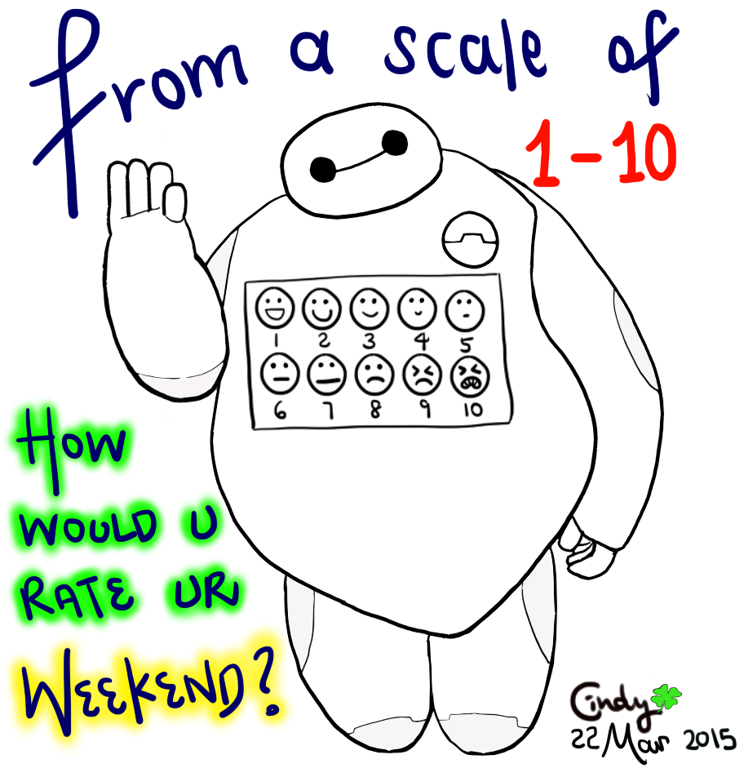

Slide 3

3 weeks until 2nd FAB
27th Feb: 1hr 30 mins.
Judaism : 1 = 10 mark question
Morality and Justice : 1 = 10 mark question and 1 = 20 mark question.
6th March: 45 mins
Existence of God: 1 = 20 mark question

Slide 4
Course content
Morality and justice
Purposes of punishment
reformation
retribution
protection
deterrence
Responses to crime
custodial sentences
non-custodial sentences
capital punishment
Religious and non religious view on these issues

Slide 5

6.2.23 Utilitarianism
Utilitarianism is an ethical and philosophical theory that determines right from wrong by focusing on outcomes.
It is a form of consequentialism.
Of all the things a person might do at any given moment, the morally right action is the one with the best overall consequences.
Internet Encyclopedia of Philosophy: Consequentialism

Slide 6

Utilitarianism has two main founders Jeremy Bentham and John Stuart Mill.

Slide 7
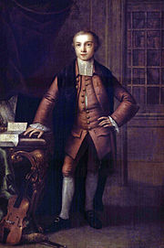
Jeremy Bentham 1748-1832
Born into a wealthy family
Was a child prodigy and was found as a toddler sitting at his fathers desk reading a large volume of the history of England.
Received his degree at 15 years old.
Concerned with social conditions
of his time and was a political
philosopher and a political radical.

Slide 8
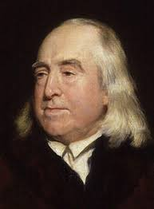
He argued for equal rights for women
He argued for the abolition of slavery
He argued that divorce should be allowed
He argued for the abolition of the death penalty
He argued that physically punishing children was wrong
He supported animal rights
A pretty radical man for his time

Slide 9
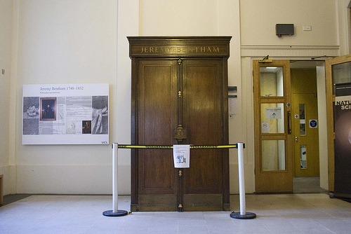

Slide 10
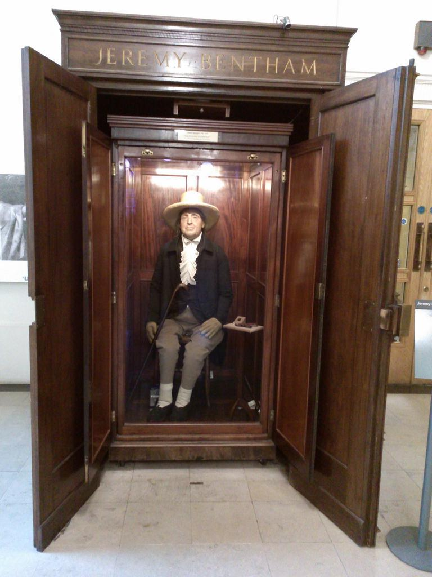

Slide 11
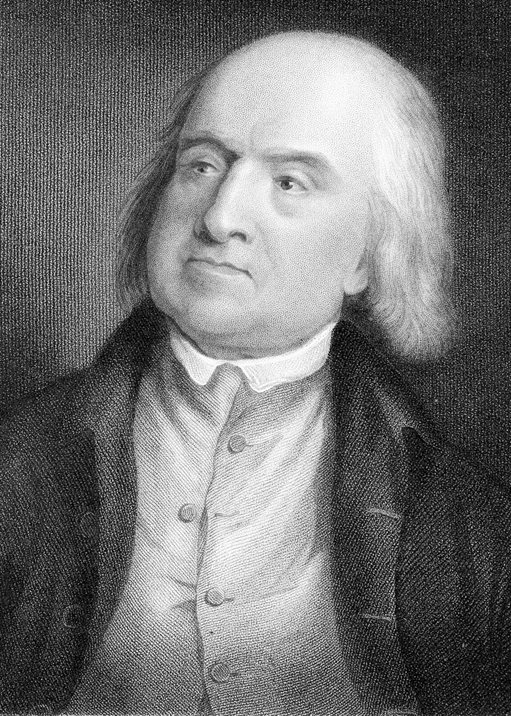
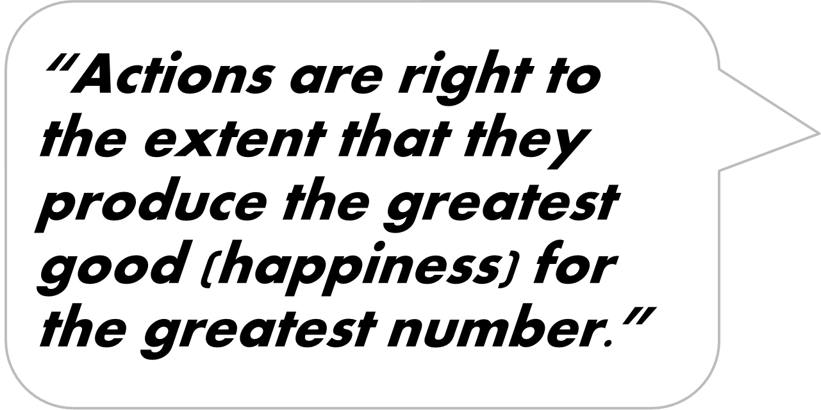
Utilitarianism says that the most ethical choice in any situation is the one that will produce the greatest good for the greatest number.

Slide 12

Utilitarianism says everyone's happiness counts the same, meaning what is good for me is not more important than what is good for everyone else.
https://www.youtube.com/watch?v=-FrZl22_79Q
There are no universal laws, so it might be considered the right thing to do to break basic laws like ‘do not steal’ if it turned out to produce the greatest happiness for the greatest number.

Slide 13
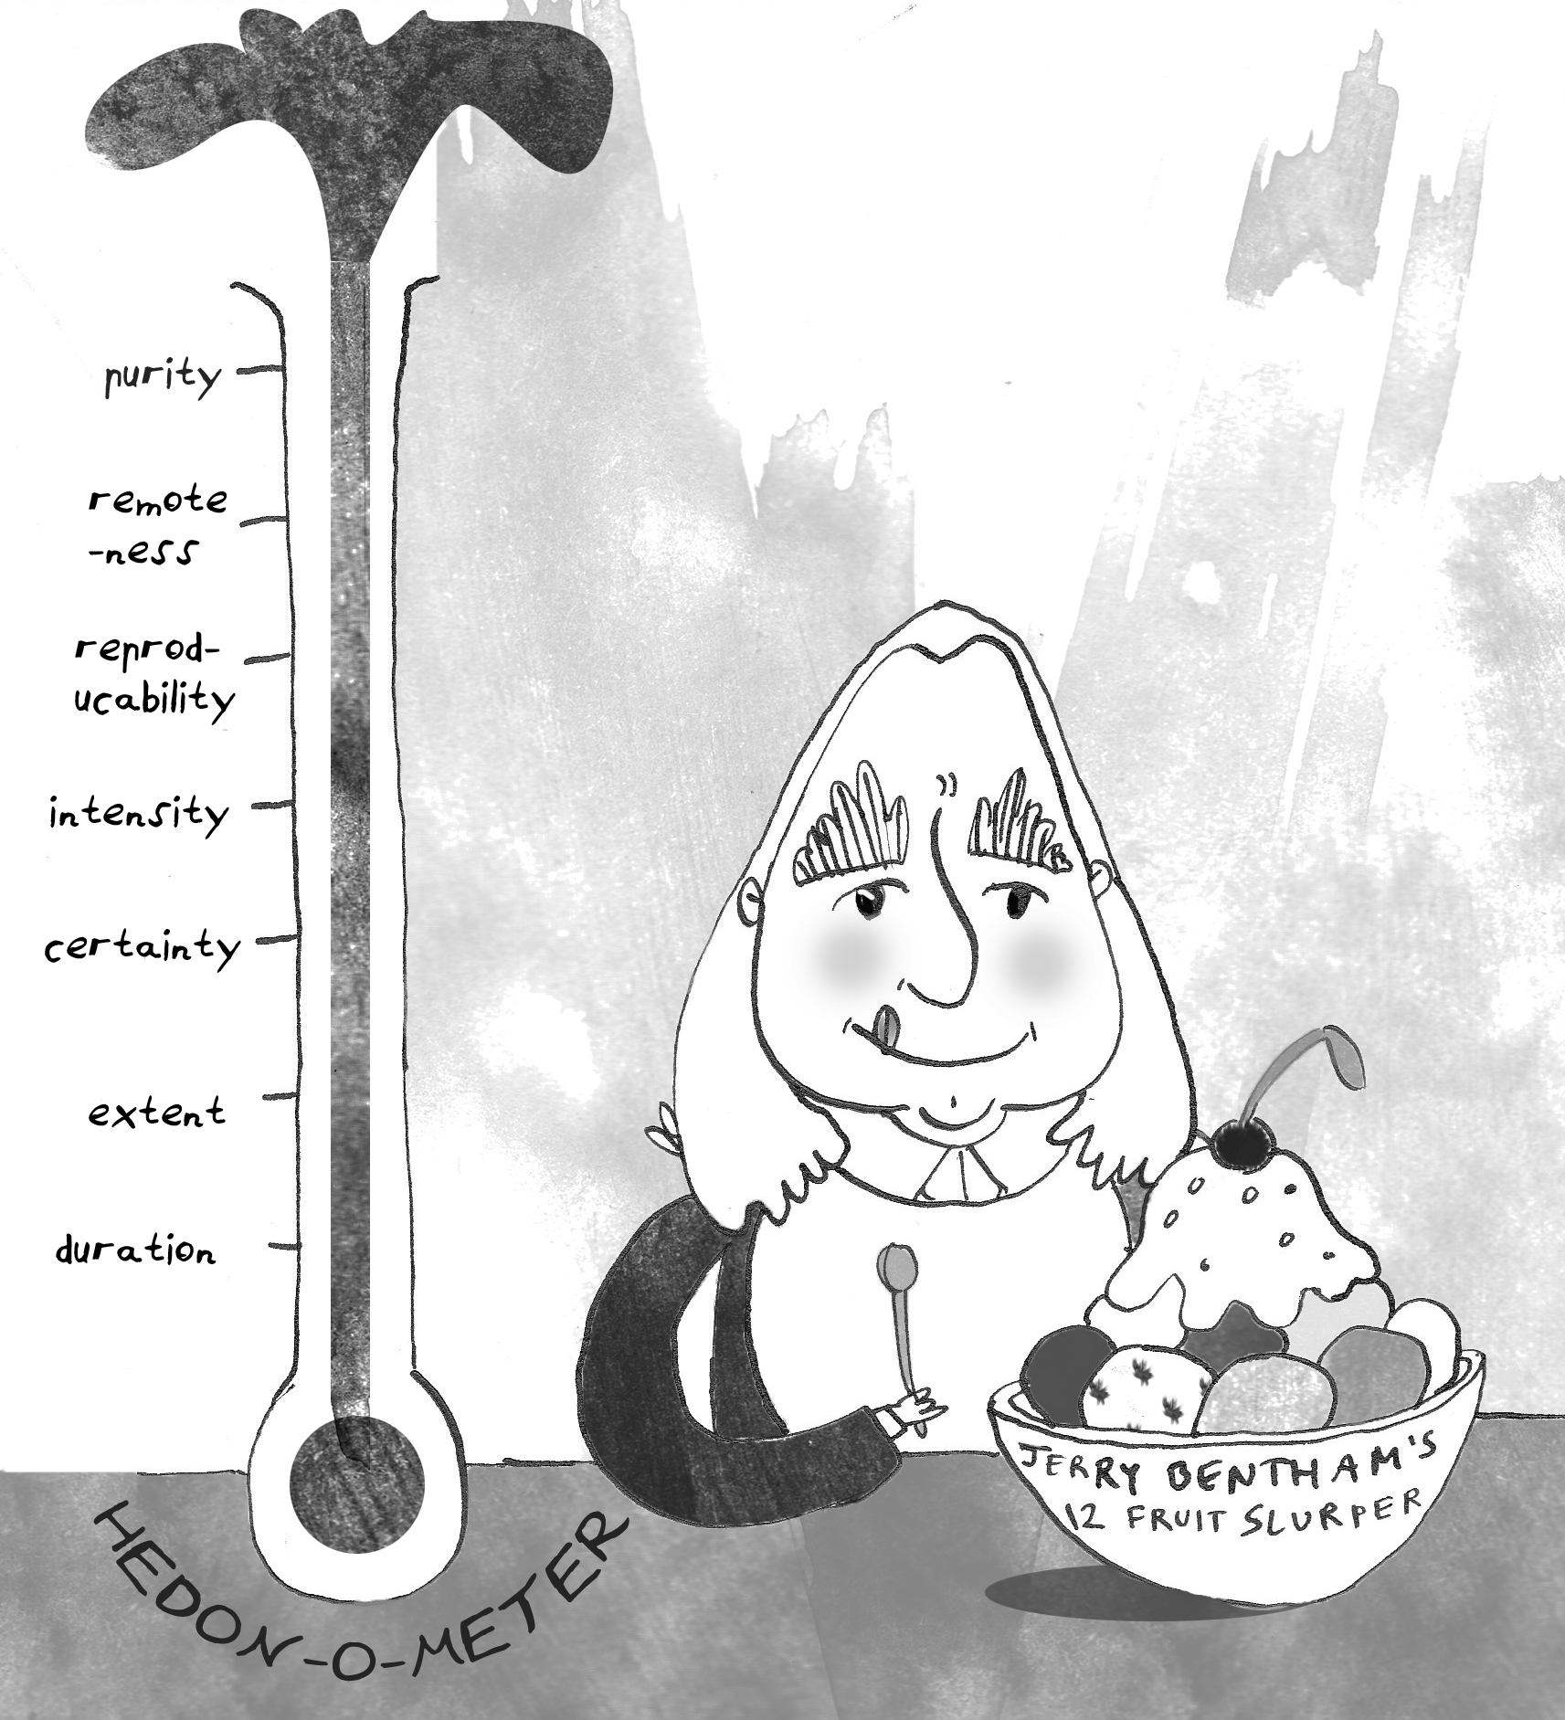
Bentham thought humans are hedonists – we are controlled by two things:
Pleasure (something we want)
Pain (something we avoid)
Therefore he thought that people should act in a way that brings about the greatest amount of pleasure, or the least amount of pain (for the majority of people).

Slide 14
He even devised a way of calculating every action and rating it for pain and pleasure. It is called the Hedonic Calculus
Purity – how free from pain is it?
Remoteness – how near is it?
Richness – to what extent will it lead to other pleasures?
Intensity – how powerful is it?
Certainty – how likely it is to result in pleasure?
Extent – how many people does it affect?
Duration – how long will it last?

Slide 15

Utilitarian response to punishment
The founder of utilitarianism Bentham said that
“ All punishment is mischief: all punishment is evil”
Why would he say this?

Slide 16



This is because:
Punishment is an evil because it inflicts pain and suffering on the individual being punished.
Utilitarianism suggests that pain is intrinsically bad, whilst pleasure is intrinsically good.
3. Singling out a person for punishment is therefore evil.

Slide 17

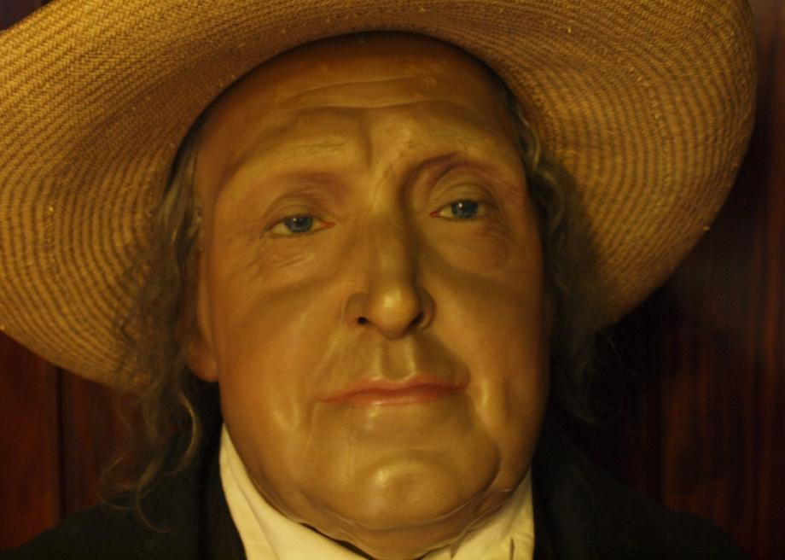
BUT
Punishment can be justified, according to a utilitarian, if this increase in unhappiness is outweighed by an increase in happiness for the majority.
A utilitarian's justification for punishing people
needs to ‘look forwards’ to the effects of punishment.
‘Punishment ought to be admitted in as far as it promises to exclude some greater evil’.

Slide 18
Lets examine the four purposes of punishment again from a Utilitarian perspective:
Protection
Deterrence
Reform
Retribution
What do you think a utilitarian would say for each purpose?

Slide 19
Protection
Deterrence
Reform
Retribution
This is acceptable as it makes society as a whole a happier place. But this still needs to be fair.
If the punishment works as a deterrent the suffering of the individual can be justified. The majority will be happy.
If a person can truly be reformed than their temporary suffering is worth it both for them and society. Long term happiness for all.
This is rarely seen as an acceptable form of punishment. It simply creates more suffering.

Slide 20

Summary:
Utilitarian’s see punishment as evil because it inflicts suffering on the individual being punished. This theory suggests that pain is bad, whilst pleasure or happiness is good. It follows then that punishing someone by treating him or her badly is evil.
However, Utilitarianism of course, looks to maximize happiness. So, punishment can be allowed if it can be seen to produce more happiness than the suffering it inflicts. E.g. does it make society happier if the criminal has been punished?
Can you see any strengths and weaknesses of this approach?

Slide 21
Written task
1. Give two reasons why a person might support the utilitarian outlook on making moral decisions.
2. Give two reason why a person might disagree with the utilitarian way of making moral decisions.

